Slide 1
How to import GDS with ITF Technology File
2022-08-01

Slide 2
About ITF
Synopsys' Interconnect Technology Format (ITF) provides detailed modeling of interconnect parasitic effects that enables designers to perform accurate parasitic extraction for timing, signal integrity, power and reliability signoff analysis. ITF offers a flexible and innovative format to accurately model the effects of increased process variation at advanced process technologies. ITF has been evolving for more than 10 years and is the semiconductor industry’s most widely used interconnect modeling format. It is supported by leading semiconductor foundries and integrated device manufacturers and is proven on thousands of production designs.
https://news.synopsys.com/2016-09-06-Synopsys-Announces-Standards-Board-Ratification-of-Its-New-Parasitic-Models-for-Latest-FinFET-Process-Nodes

Slide 3
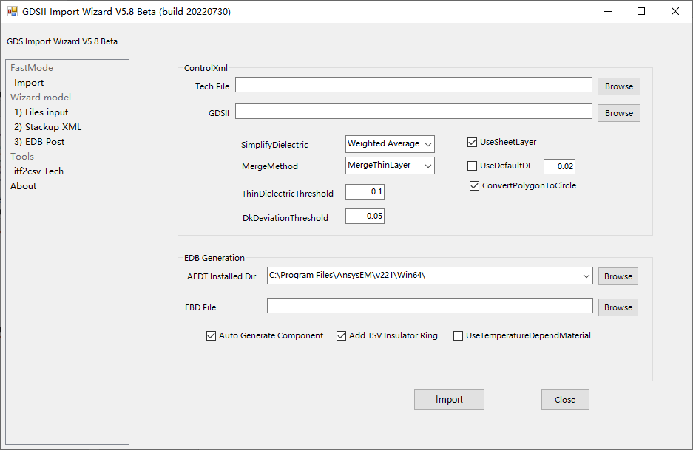
About GDS Import Wizard
GDS Import Wizard is a free tool, which is used to easily import GDS into ANSYS HFSS 3D layout for high-precision full wave analysis.
The latest tools is released at GitHub.
https://github.com/YongshengGuo/GDSImportWizard/releases/latest

Slide 4
GDS Import Workflow for ITF Technology File
ITF Tech
CSV Tech
GDS Control XML
GDS Importing
Analysis
Add LayerMap
Add Nets List
Add Components

Slide 5
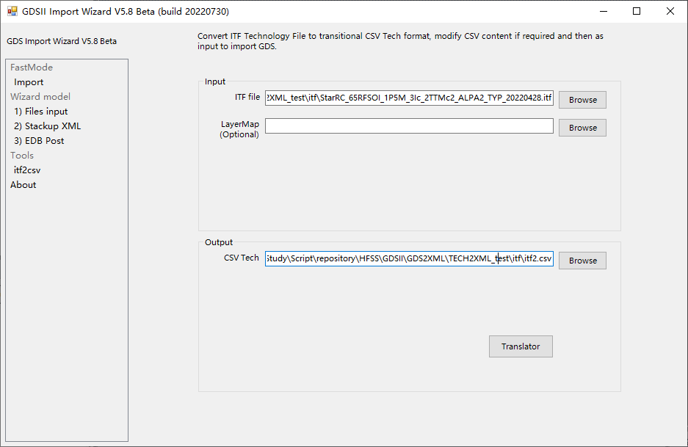
Step1. Translate ITF to CSV Tech
① Browse ITF file
② Set CSV output Path
③ Click Translate

Slide 6
About CSVTech
NO | LayerName | Type | LayerMap | TextLayerMap | Thickness | Height | LowerLayer | UpperLayer | DK | DF | Cond | TC1 | TC2 | Tref
1 | UF1 | D |  |  | 35 | 107.64 |  |  | 3.7
19 | IMD1a | D |  |  | 0.05 | 100.75 |  |  | 8.1
20 | ILD | D |  |  | 0.75 | 100 |  |  | 4
21 | substrate | D |  |  | 100 | 0 |  |  | 11.9 |  | 10
22 | PASSB1 | D |  |  | 0.8 | -0.8 |  |  | 6.7
23 | PASSB2b | D |  |  | 2 | -2.8 |  |  | 6.7
24 | PASSB2a | D |  |  | 0.4 | -3.2 |  |  | 6.7
25 | underFill_C | D |  |  | 0.001 | -3.201 |  |  | 6.7
26 | ubump | C | 170;0 74;0 | 125;0 | 0.001 | 142.639 |  |  |  |  | 5.80E+07 | 0.00E+00 | 0.00E+00 | 25.00
27 | metal4 | C | 74;0 |  | 1.45 | 105.19 |  |  |  |  | 5.80E+07 | 3.89E-03 | -1.50E-07 | 25.00
28 | metal3 | C | 33;40 |  | 0.85 | 103.565 |  |  |  |  | 5.80E+07 | 3.63E-03 | -1.39E-06 | 25.00
29 | metal2 | C | 32;40 |  | 0.85 | 102.12 |  |  |  |  | 5.80E+07 | 3.63E-03 | -1.39E-06 | 25.00
30 | ctm | C |  |  | 0.08 | 101.793 |  |  |  |  | 5.80E+07 | 0.00E+00 | 0.00E+00 | 25.00
31 | cbm | C |  |  | 0.2 | 101.575 |  |  |  |  | 5.80E+07 | 0.00E+00 | 0.00E+00 | 25.00
32 | metal1 | C | 31;40 |  | 0.85 | 100.675 |  |  |  |  | 5.80E+07 | 3.63E-03 | -1.39E-06 | 25.00
33 | mb1 | C | 31;100 |  | 0.001 | -0.801 |  |  |  |  | 5.80E+07 | 0.00E+00 | 0.00E+00 | 25.00
34 | ubmb | C | 170;100 | 125;100 | 0.001 | -3.201 |  |  |  |  | 5.80E+07 | 0.00E+00 | 0.00E+00 | 25.00
36 | via4 | V | 86;0 |  |  |  | metal4 | ubump |  |  | 5.80E+07
37 | via3 | V | 85;0 |  |  |  | metal3 | metal4 |  |  | 5.80E+07
38 | via2 | V | 52;40 |  |  |  | metal2 | metal3 |  |  | 5.80E+07 | 3.63E-03 | -1.39E-06
39 | ctm_via | V |  |  |  |  | ctm | metal2 |  |  | 5.80E+07 | 0.00E+00 | 0.00E+00
40 | cbm_via | V |  |  |  |  | cbm | metal2 |  |  | 5.80E+07 | 0.00E+00 | 0.00E+00
41 | via1 | V | 51;40 |  |  |  | metal1 | metal2 |  |  | 5.80E+07
42 | tsv | V | 251;0 86;0 |  |  |  | mb1 | metal1 |  |  | 5.80E+07
43 | pmb | V | 5;100 |  |  |  | ubmb | mb1 |  |  | 5.80E+07
44 | tsv | I |  |  | 0.15 |  |  |  | 4
CSVTech_overlapping_template.csv is in the folder of the toolkit.

Slide 7
Column Definition - CSV Tech overlapping template
LayerName is the names will be uesd in 3D Layout stackup, should be present.
Type, C : Conductor/Metal layer, V : Via layer, D : Dielectric layer, I : Insulating layer
Via Group and SnapViaGroups will be implemented on all Via layers.
Insulating layer is designed to define TSV insulation thickness, it must have a LayerName that have defined in Via Layers, or will be ignore
LayerMap indicates the layer mapping in GDS file.
Conductor/Metal and Via layer must have LayerMap value or will be ignore.
Multiple layermap Mapping could set to one layer separated with space, e.g. 86;0 85;0
TextLayerMap indicates which layer used to extract net list in GDS,
the layermap in GDS should have net information.
Thickness is set for Dielectrics/ Metals/Vias layer thickness, the default unit is um.
Height indicates position of the layer in stackup
All Height define in the lower of the layer, dielectrics Layers or Metal/Vias layers will be reordered by Height value, respectively.
If dielectrics Height not give, the height will be obtained by accumulating the thickness of dielectrics layer (invert order)
If Metal and Vias Height not give, the height will be obtained by accumulating the thickness of Metal and Vias layer (invert order)
The last dielectric layer is the origin, all height (D/C/V) value refer to this value, negative value is accepted.

Slide 8
Column Definition - CSV Tech overlapping template
LowerLayer, UpperLayer defined the start and end layer of via layer
If LowerLayer, UpperLayer not give, the adjacent layers will set to LowerLayer, UpperLayer
LowerLayer, UpperLayer determines the thickness of the via layer, which have higher priority the via Thickness property
DK, DF, Cond is used to set Material properties of the layers
TC1, TC2, Tref is the temperature coefficient of conductivity, use for corner analysis
temperature-dependent material (conductivity) will be used if check UseTemperatureDependMaterial option in GUI
The formular is Cond/(1+(TC1*($Temp-Tref))+(TC2*($Temp-Tref)**2))
Tref is the base temperature, which defines the current conductivity

Slide 9
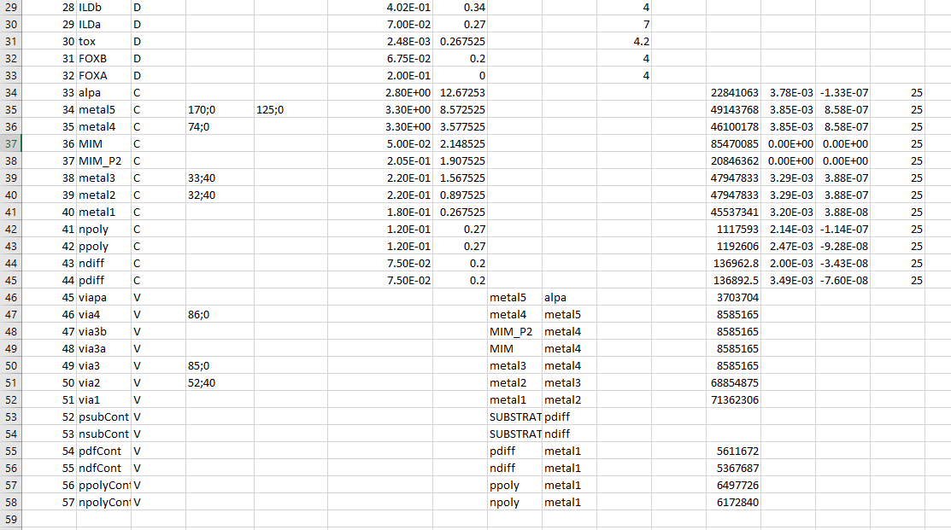
Step2: Add LayerMap
Add Layermap for Layers you want import.
1) Layermap only added for Conductor and Via Layer.
2) Layers Without layermap will not import to 3D Layout
3) TextLayermap used to extract net information.
4) Make sure imported via layer lower/upper layer have valid layermap
Refer to GDS Import Wizard manual for more detail. (attached with the toolkit in Github.)

Slide 10
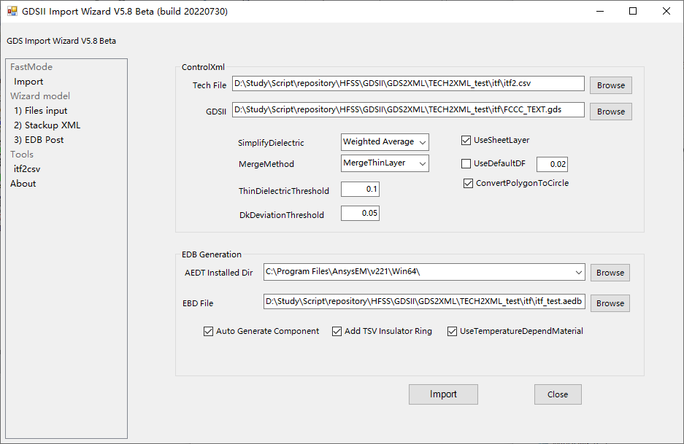
Step2: Import GDS
①CSV Tech which got from itf2csv with layermap
②GDS file will be imported to 3DL
③ 3DL save path
④Check “UseTemperatureDependMaterial”if you want consider temperature effects.

Slide 11
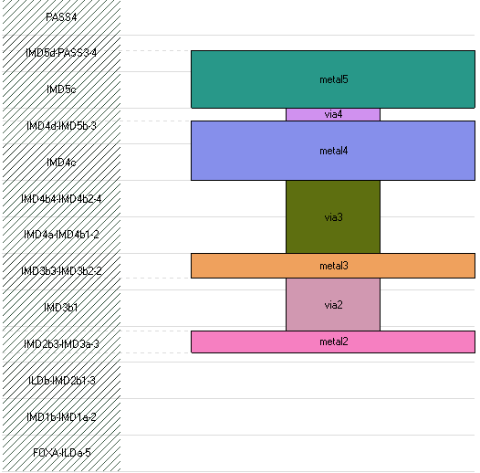
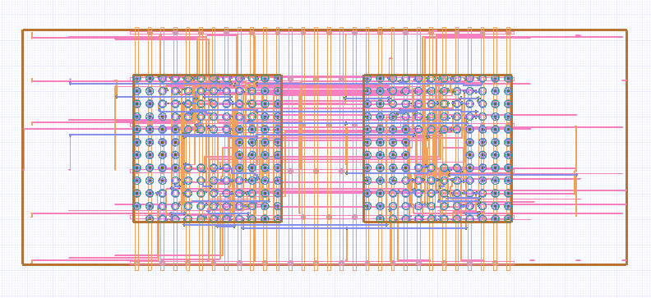
Next: please enjoy to setting solver option and analysis

Slide 12
End

